Slide 1
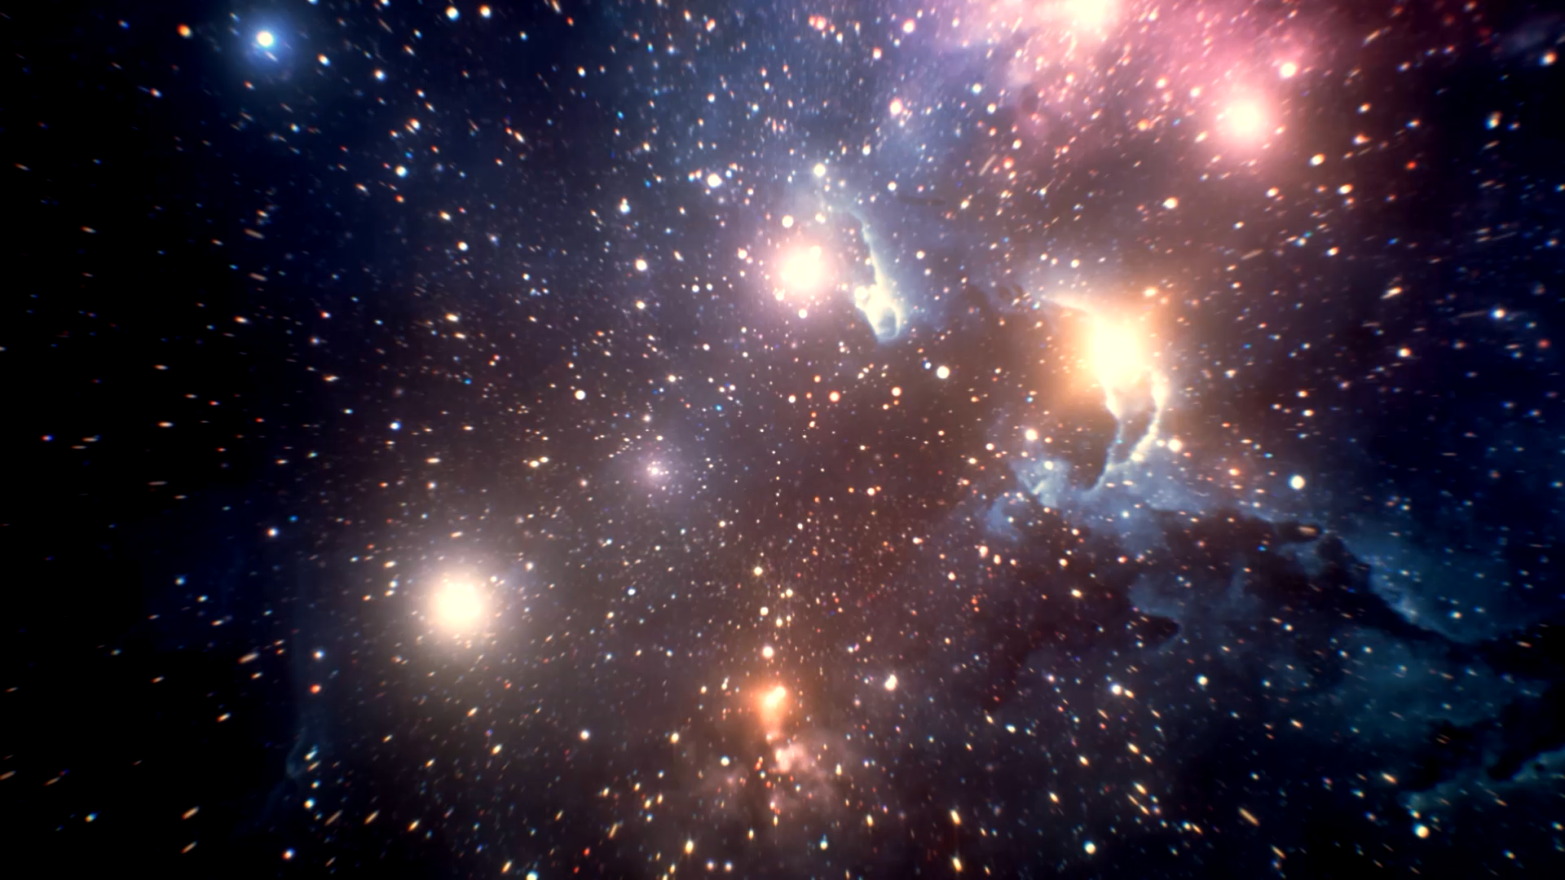
We all love Molecules
THE UNIVERSE
IS #5

Slide 2
Lecture Recap
What is one thing you remember from the lecture?

Slide 3
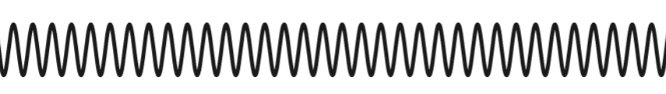
Central idea: Energy states associated with nuclei motion
Rotational
Vibrational

Slide 4
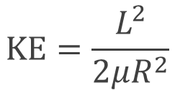
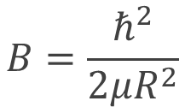
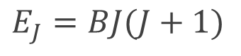
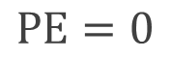
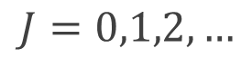
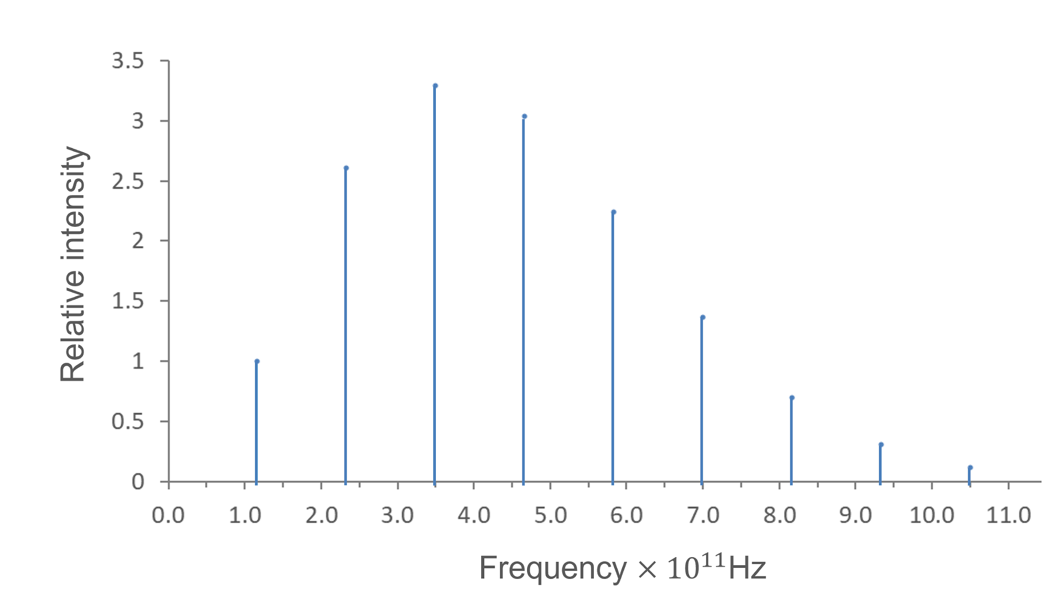
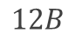
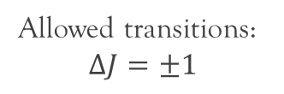
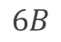

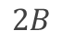

Rotational motion
Quantum

Slide 5
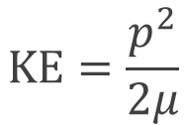
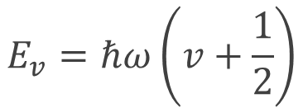
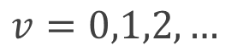
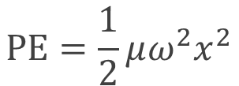
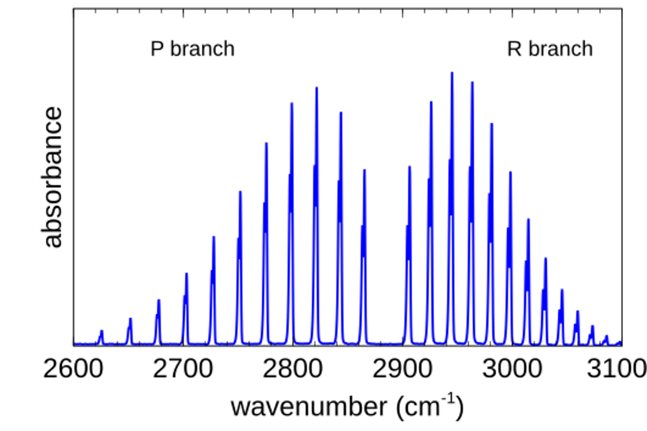
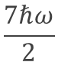


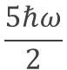
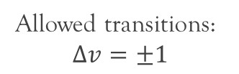
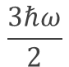
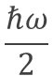

Vibrational motion
Quantum
+
rotational transitions

Slide 6
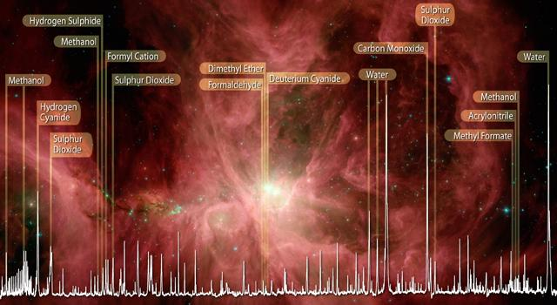
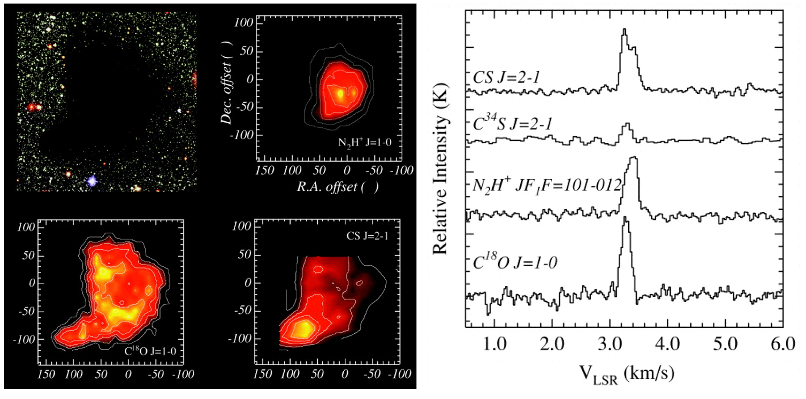
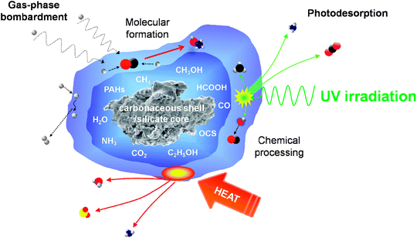
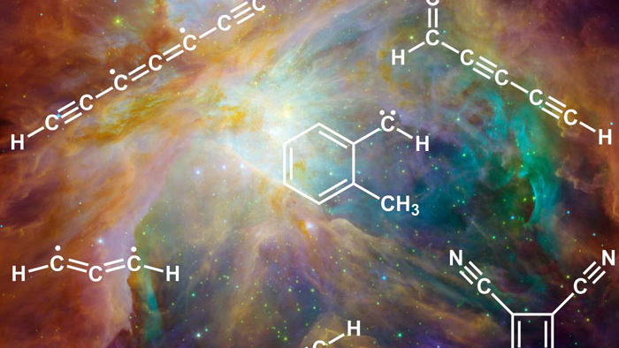
Astro-chemists do some really cool stuffs!

Slide 7
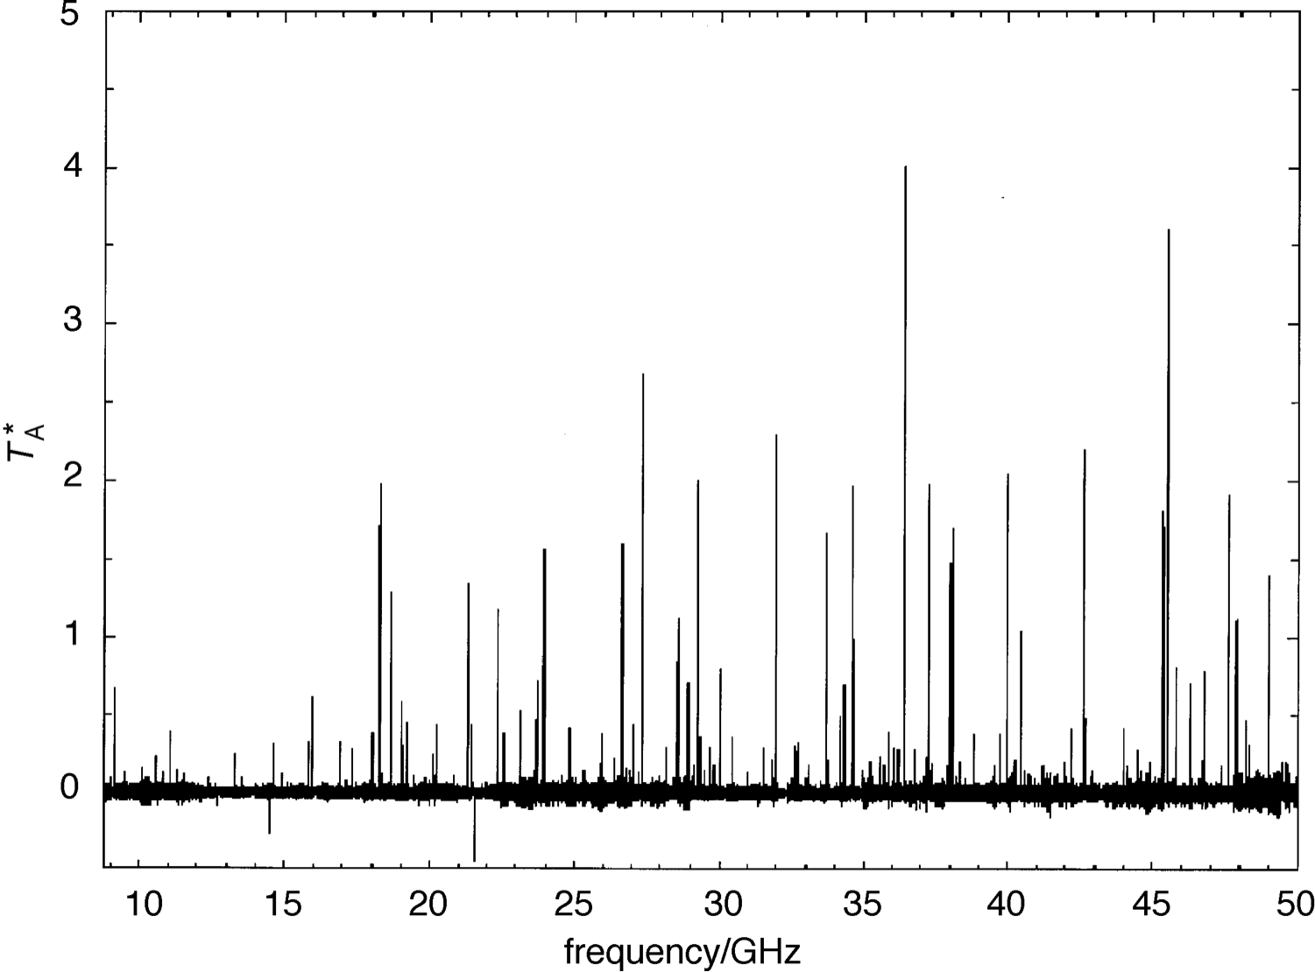
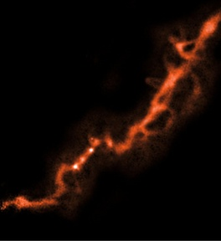
Microwave spectroscopy of TMC-1. Peaks corresponds to rotational transitions of molecules in TMC-1.
Ex. Identify peaks that correspond to the same molecular species. Estimate the rotational constants.
Taken from M. Ohishi, N. Kaifu, Faraday Discuss, 109, 205 (1998)

Slide 8
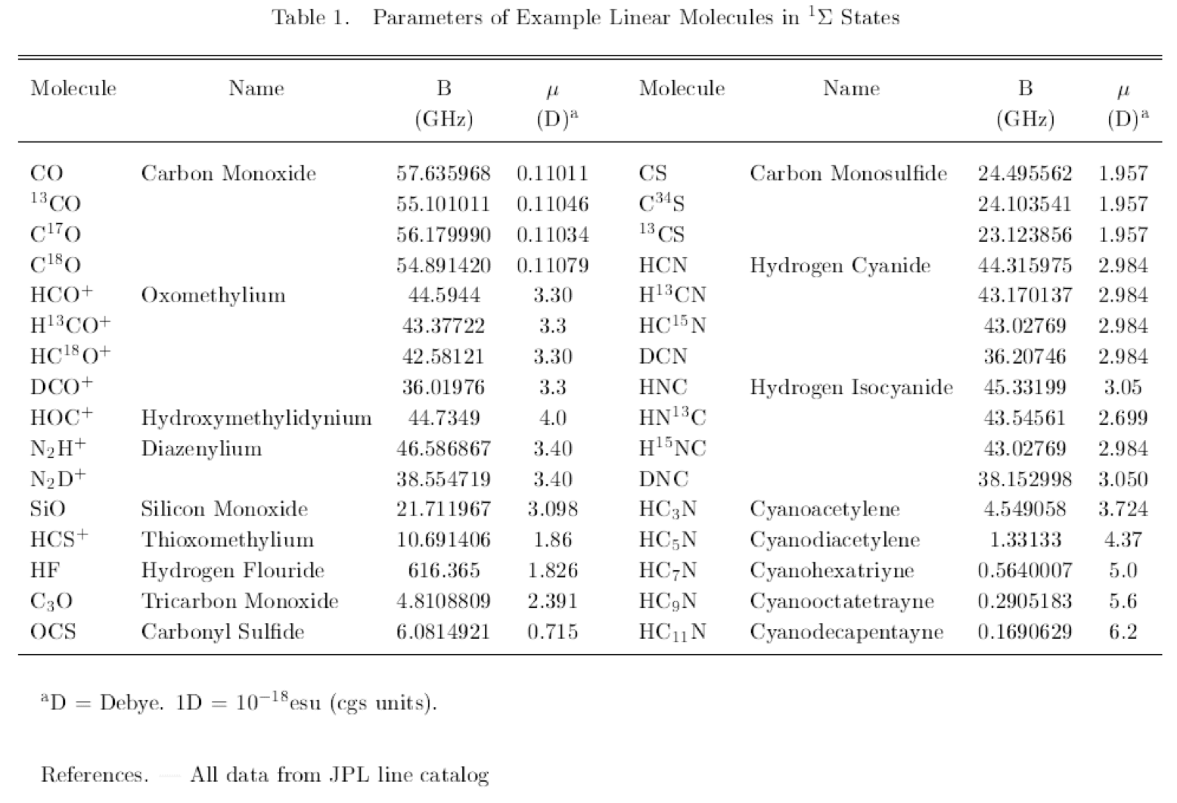

Slide 9

Discussion Questions

Slide 10
Q3
The figure below is a simulated rotation spectrum of CO. Estimate the internuclei distance of CO.

Slide 11
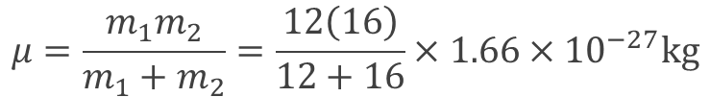
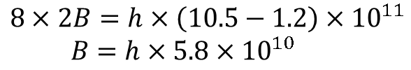
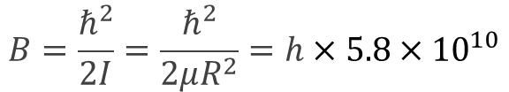
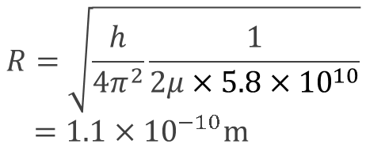
Q3
Reduced mass of CO:
The figure below is a simulated rotation spectrum of CO. Estimate the internuclei distance of CO.
From the graph:
From notes, rotational constant:

Slide 12


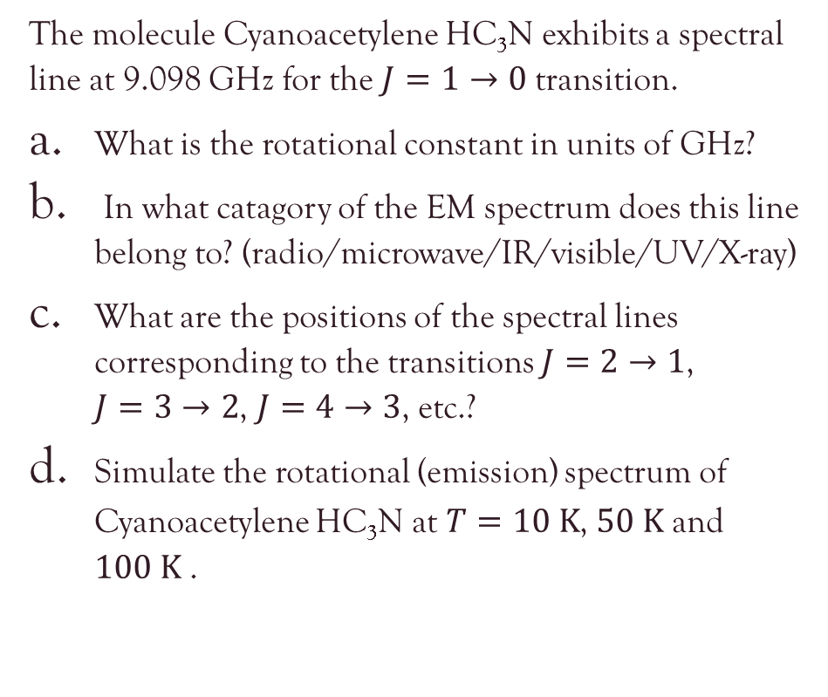

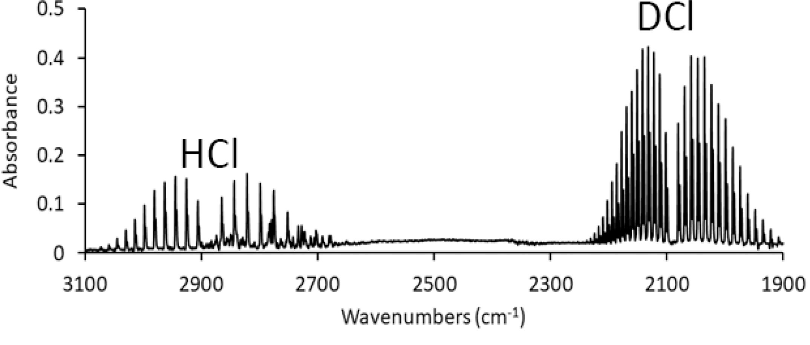
Q4
Q5
Derive an expression for the most probable J transition line for rotational spectroscopy. (Hint: use Eq.(QM(6))).
Suggest how we can estimate the temperature of the observed object using rotational spectroscopy.
Q6
By referring to the following figure, suggest why the range of isotopes would result in a different wavenumber.

Slide 13
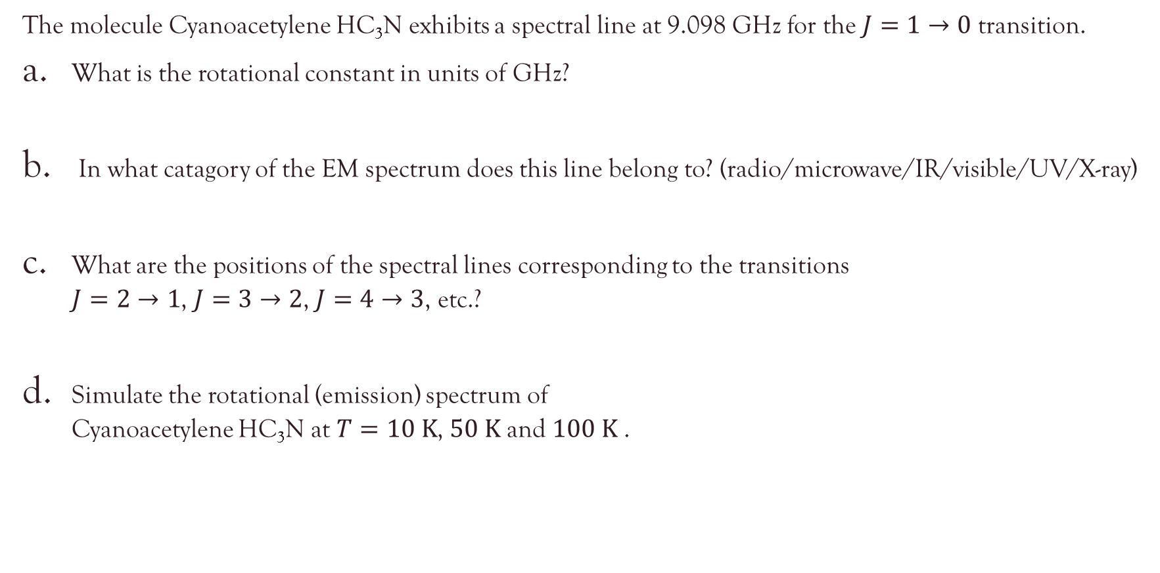
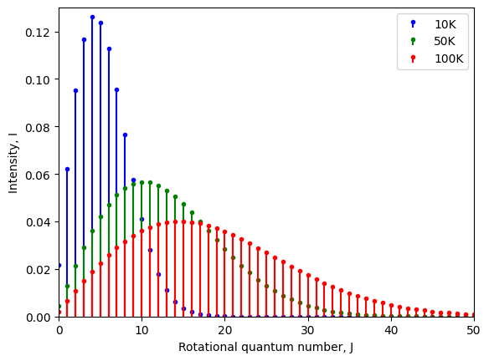
Q4
Microwave/Radiowave
18.196, 27.294, 36.392, …

Slide 14
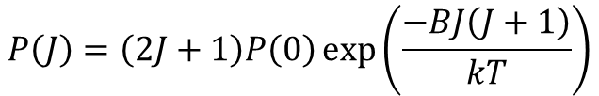
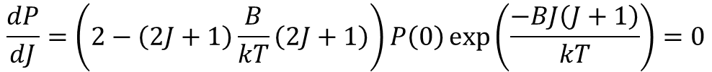
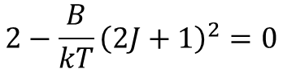
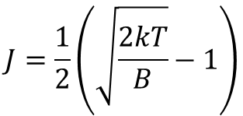
Q5
Derive an expression for the most probable J transition line for rotational spectroscopy. (Hint: use Eq.(QM(6))).
Suggest how we can estimate the temperature of the observed object using rotational spectroscopy.

Slide 15
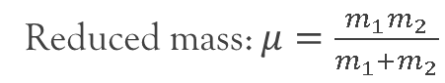
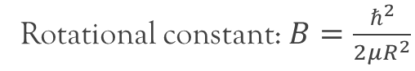
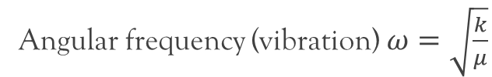
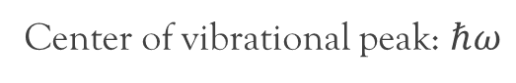
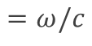
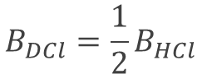

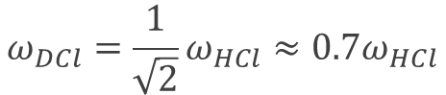
Q6
By referring to the following figure, suggest why the range of isotopes would result in a different wavenumber.
Mass of D = 2 * (Mass of H)

